Slide 1
Day 4 Afternoon: Experiment and Data Analysis
Prof. Shengdong Zhao

Slide 2
Introducing repeated-measure factorial ANOVA
Within-subject design
More than 1 factors, each with multiple levels

Slide 3





Example, Practice, and Discuss

Slide 4
Let’s do a simple within-subject experiment together that measures your workload for certain tasks

Slide 5
Question: how to measure workload?

Slide 6
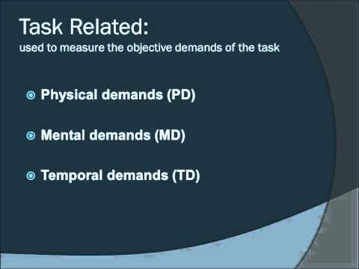
Introducing NASA TLX

Slide 7
Here are the experimental tasks

Slide 8

Experimental task 1 - visual search

Slide 9
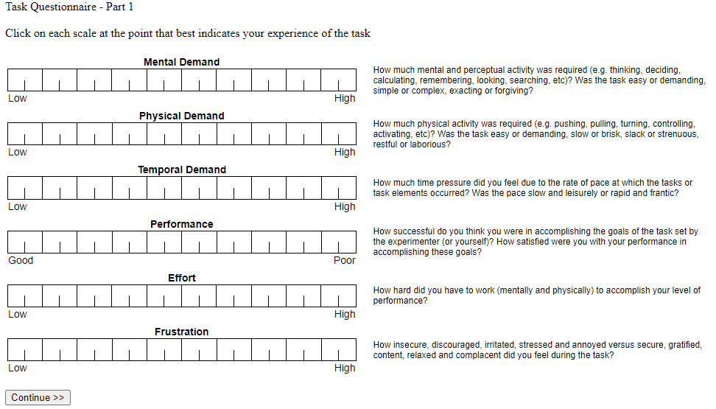
Fill out the online form
https://www.keithv.com/software/nasatlx/nasatlx.html

Slide 10
Copy & paste your score into the google spreadsheet following the example
https://docs.google.com/spreadsheets/d/13uED21beaa8Pms6tA3O8H62nFQPOc4_eIXMOSeesuME/edit?gid=0#gid=0

Slide 11
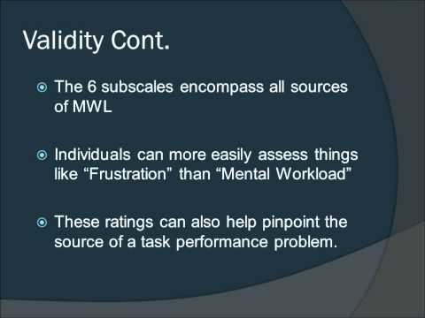
Caveats about NASA TLX

Slide 12
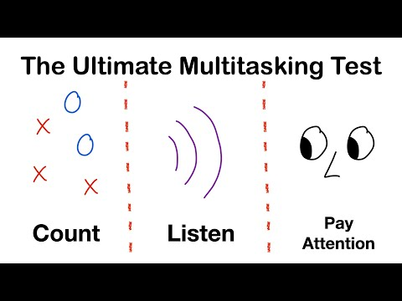
Experiment task 2 - Visual multitasking

Slide 13
Fill out the online form
https://www.keithv.com/software/nasatlx/nasatlx.html
How to perform the simpler, 1 step NASA TLX？
Only perform part 1 of the online form
Skip part 2 by always click on the first item in the comparison
During calculation, ignore the weightage and place equal weights on all 6 categories

Slide 14
Copy & paste your score into the google spreadsheet:
https://docs.google.com/spreadsheets/d/13uED21beaa8Pms6tA3O8H62nFQPOc4_eIXMOSeesuME/edit?gid=0#gid=0

Slide 15
Now let’s add another factor
Type of activity

Slide 16
Previously, you perform the tasks while sitting down, now let’s do the task while you are “running on a treadmill”*
*Don’t worry, you don’t have to actually run, just imagine doing the same task while running

Slide 17
Redo the experimental task (visual search)
Imagine you did this
task while running

Slide 18
Fill out the online form (1 step approach)
https://www.keithv.com/software/nasatlx/nasatlx.html

Slide 19
Copy & paste your score into the google spreadsheet:
https://docs.google.com/spreadsheets/d/13uED21beaa8Pms6tA3O8H62nFQPOc4_eIXMOSeesuME/edit?gid=0#gid=0

Slide 20
Redo experiment task 2 - Visual multitasking
Imagine you did this
task while running

Slide 21
Fill out the online form (1 step approach)
https://www.keithv.com/software/nasatlx/nasatlx.html

Slide 22
Copy & paste your score into the google spreadsheet:
https://docs.google.com/spreadsheets/d/13uED21beaa8Pms6tA3O8H62nFQPOc4_eIXMOSeesuME/edit?gid=0#gid=0

Slide 23
Now let’s perform the analysis using JASP https://docs.google.com/spreadsheets/d/1Yn23qf51Vq_dI1hSbsJp9ne5FJVz6eSbvuq34NJeN20/edit?gid=2132750171#gid=2132750171

Slide 24
Report your data using the template on the next slide

Slide 25
How to report results?
A one-way ANOVA (replace with the type of test performed) was performed to compare the effect of [independent variable(s)] on [dependent variable].
A one-way ANOVA (replace with your test) revealed that there [was or was not] a statistically significant difference in [dependent variable] between at least two groups (F(between groups df, within groups df) = [F-value], p = [p-value]).
Tukey’s HSD Test (replace with your test) for multiple comparisons found that the mean value of [dependent variable] was significantly different between [group name] and [group name] (p = [p-value], 95% C.I. = [lower, upper]).
There was no statistically significant difference between [group name] and [group name] (p=[p-value]).
General structure
A brief description of the independent and dependent variable.
The overall F-value of the ANOVA and the corresponding p-value.
The results of the post-hoc comparisons (if the p-value was statistically significant).

